Slide 1

Visualization and Analysis –
Tutorial Presentation for Feedback
Date:
Group Id: A125 Name of Student Presenting:

Slide 2
This dataset is interesting to us because:
It provides real restaurant information, allowing us to explore how different restaurant features relate to customer ratings.
Our Independent variable is: Restaurant_Type
This is the category of restaurant (e.g., Casual Dining, Café, Bar).
This Independent variable datatype is: Nominal
Our Dependent variable is: Ratings_out_of_5
This is the customer rating score given to each restaurant.
This Dependent variable datatype is: Interval/measurement data
We are using the dataset ds236 Zomato_Pune
Restaurant_Name Ratings_out_of_5
<chr> <chr>
1 AB's - Absolute Barbecues 4.9
2 Cafe Co2 Resto Lounge 4.6
3 Paasha - JW Marriott Pune 4.6
4 I Amsterdam 4.3
5 FC Road Social 4.5

Slide 3
Our Research Question is - Is there a difference in the average customer rating (Ratings_out_of_5) among restaurants of different restaurant types (Restaurant_Type) listed in the Zomato Pune dataset?
Null Hypothesis (H₀):
There is no difference in the mean of customer ratings (Ratings_out_of_5) among different restaurant types (Restaurant_Type).
Alternative Hypothesis (H₁):
There is a difference in the mean of customer ratings (Ratings_out_of_5) among different restaurant types (Restaurant_Type).

Slide 4
1. Boxplots (to include outliers) (place the dependent variable on the y-axis and independent variable sub-categories on the x axis)
2. A histogram to include the normal curve overlay. The histogram plots data from your dependent variable only.
Clearly label you axes to include variable name in proper English, and units of measurement (e.g. currency $, type of weight kg, etc). Include a title to give your plot/visualisation a context.
Correlation: Included two visualizations
Comparison of means (or medians) analyses the difference between the mean (or median) value of a characteristic shared by members of two (or more) different populations/values.

Slide 5
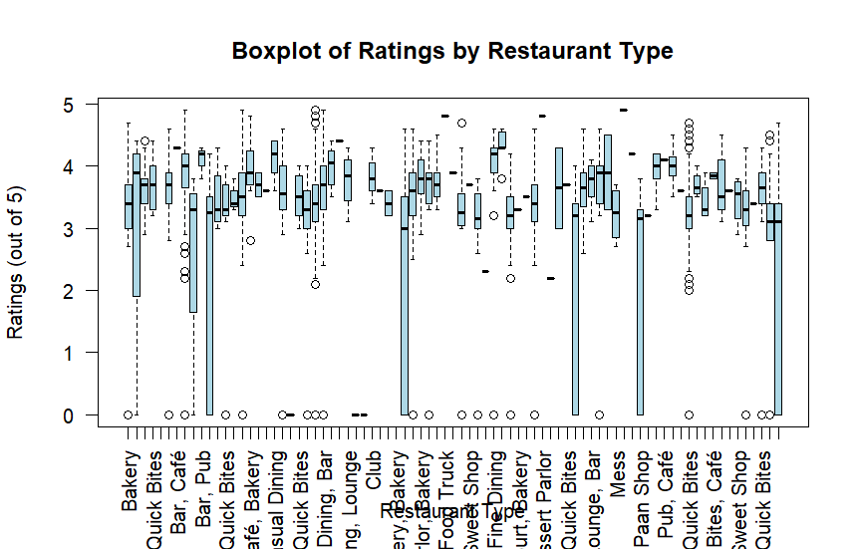
Part 1: VISUALISATION (Boxplots)

Slide 6
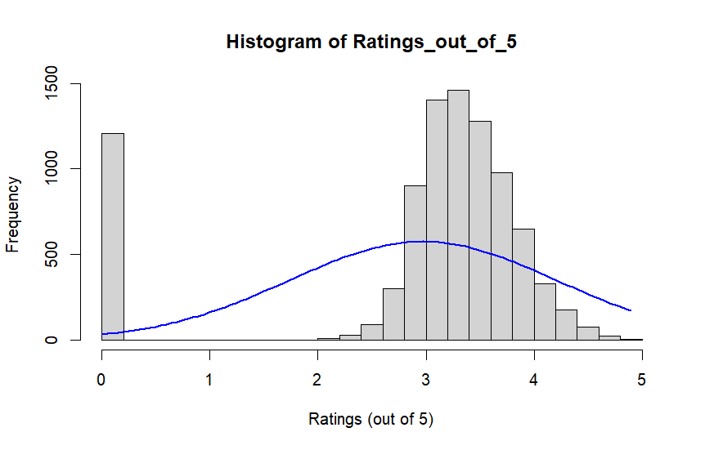
Part 1: VISUALISATION (Histogram)

Slide 7
Part 2: Analysis (building on your Visualizations)

Slide 8
Here is a Histogram showing the frequencies of our dependent variable to include the normal curve overlay.
Our RQ asks about Correlation
:
The normal curve overlay does not follow the shape of the underlying data, so for our analysis we use the non-parametric test for correlation that does not assume normality: Spearman’s Rho or Kendal’s Tau
8
Notes:
8

Slide 9
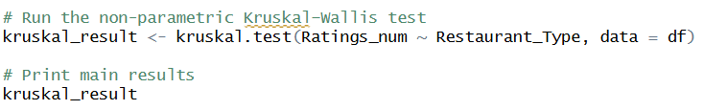

R Script and Results (For ALL types of test) – The Analysis
PRE 7COM1079-2022 Student Group No: ?????
9
Include a snippet of the R code you use to calculate your test statistic.
Notes:
9

Slide 10
R Script and Results (For ALL types of test) – The Analysis
PRE 7COM1079-2022 Student Group No: ?????
10
Give the value of the test statistic.
The analysis produced one test statistic because our research question concerns a comparison of median ratings across multiple restaurant types, and the dependent variable did not meet normality assumptions. Therefore, we used the non-parametric Kruskal Wallis test.
Tell us the p-value. Is the p-value > or < 0.05?
The p-value for the Kruskal Wallis test is p = [insert p-value], which is [greater/less] than the 0.05 significance threshold.
Because the p-value is [likely less than 0.05], this indicates that the probability of observing such differences in ratings across restaurant types by chance alone is very small.
Notes:
10

Slide 11
R Script and Results (For ALL types of test) – The Analysis
PRE 7COM1079-2022 Student Group No: ?????
11
Is the result significant?
Yes, the results are statistically significant. When p-values fall below the 0.05 threshold, we conclude that the observed differences across groups are unlikely to have occurred due to random variation in the data. In our analysis, the p-value from the Kruskal–Wallis test is well below this threshold, providing strong statistical evidence that customer ratings differ across restaurant types.
Do you ‘fail to reject the null hypothesis’ or ‘reject the null hypothesis’?
We reject the null hypothesis.
For the Kruskal–Wallis test, the null hypothesis states that all restaurant types share the same distribution of customer ratings. The very small p-value provides sufficient evidence to reject this null hypothesis and conclude that at least one restaurant type differs significantly in its customer rating distribution.
Notes:
11

Slide 12
R Script and Results (For ALL types of test) – The Analysis
PRE 7COM1079-2022 Student Group No: ?????
12
What does the result actually mean in the wider context of learning something useful / answering your RQ?
The result helps us understand how restaurant type relates to customer experiences in a real-world setting. Since the Kruskal–Wallis test shows a statistically significant difference in customer ratings across restaurant types, this indicates that certain categories of restaurants tend to receive higher or lower ratings than others. This means that restaurant type does play a meaningful role in shaping customer perceptions on Zomato in Pune. In practical terms, this insight can guide restaurant owners, managers, and analysts by highlighting which types of dining venues are more positively received, and where improvements may be needed. It also answers our research question by showing that customer ratings are not evenly distributed across all restaurant types—suggesting that factors associated with different restaurant categories may influence how customers evaluate their dining experience.
Notes:
12

